Slide 1
An Automated Evaluator for Bharatanatyam (Nritta)
Paper ID : CS 4008
Authors: Renu S Hiremath, Shreya Bhat & Srikanth H R
PES Institute of technology, bangalore

Slide 2
Bharatanatyam

Slide 3
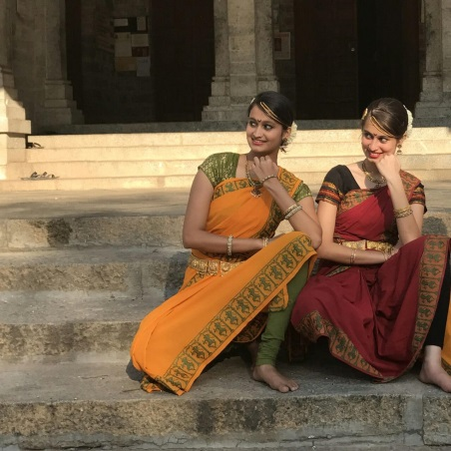
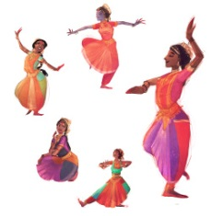
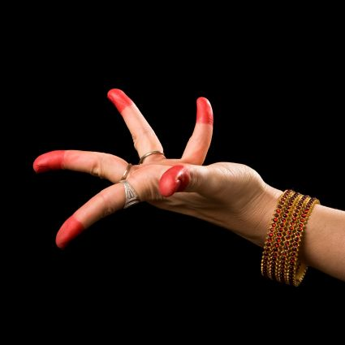
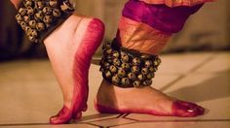
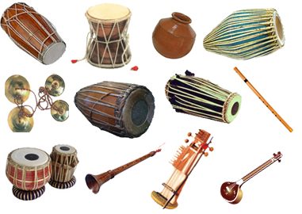
The basic unit of dance in Bharatanatyam is the adavu.
The hand gestures of Bharatanatyam are called hastas..

Slide 4
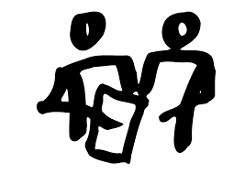
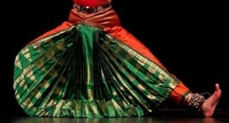
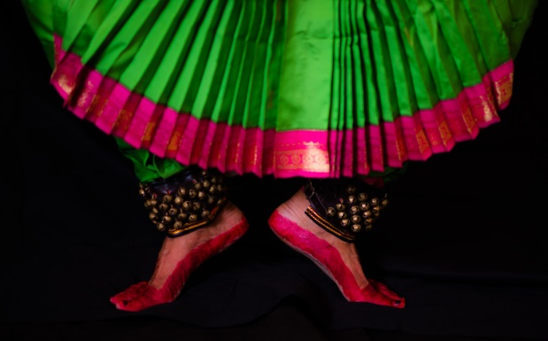
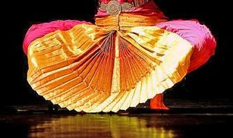
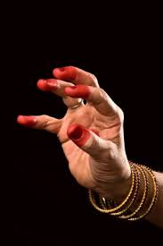
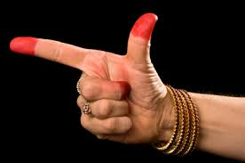
Dance Examination

Slide 5

Problem?
The difference of opinion between different zones has put the validity of examinations for various levels of Bharatanatyam being held in Mangalore in a clutter. While the examinations in the Bangalore zone was carried out by May 15, the same for Mangalore has run into trouble with judges and examiners belonging to the state capital giving the tests in the coastal city a miss. The understanding was that Bangalore zone will send its teachers as judges in Mangalore and vice versa. It is alleged that Mangalore is always left high and dry. “This injustice has been happening to the students in Mangalore zone for more than 10 years and we are tired of the crisis every year. The worst thing is that we have to bring in the local gurus to act as judges and some of them assign more marks to their own students and less marks to others.

Slide 6
Dance Examination – Problems faced
The state level Junior and Senior level Bharatanatyam Examinations are conducted every year, which require a minimum of two judges evaluating an individual for about 1-2 hours each.
There are three main problems faced:
Insufficient number of judges
Inconsistent evaluation since the candidate is entirely graded based on just the “opinion” of the two judges
Under-qualified judges

Slide 7
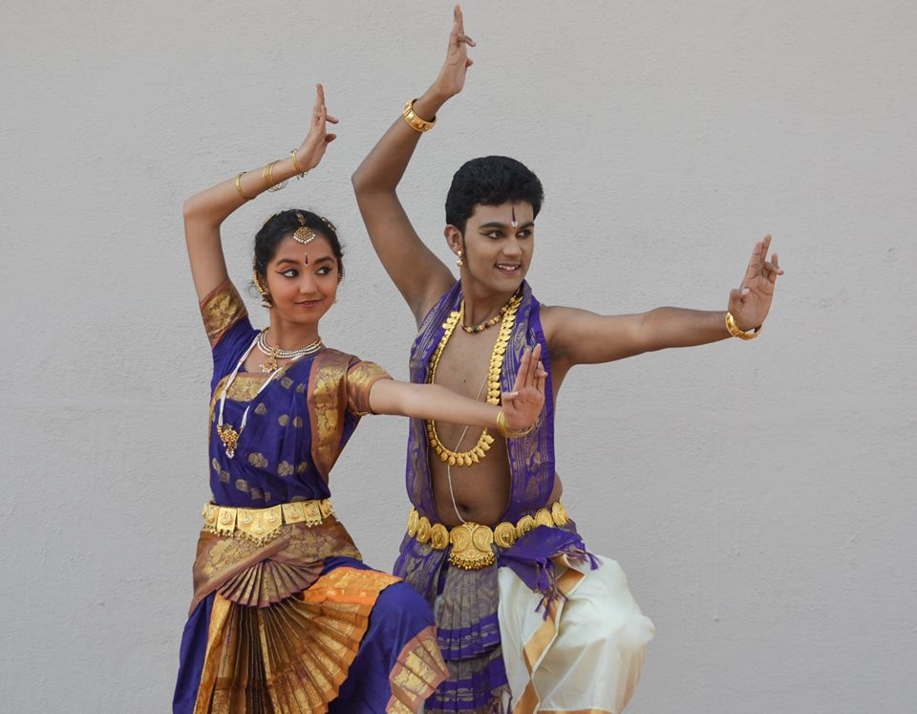
Why we chose Bharatanatyam?
The movements of Bharatanatyam are unique.
They share elements with other classical Indian dances, but aren’t found in any western dance style.
They are often described as geometric.

Slide 8
Previous Work
Research related to posture recognition of Dancers

Slide 9
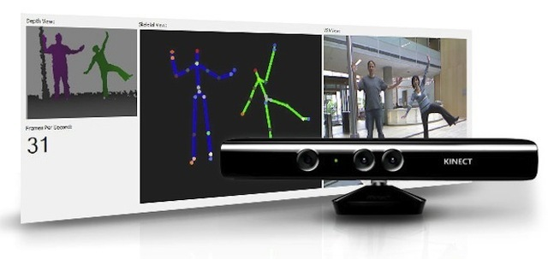
Kinect
Kinect is a line of motion sensing input devices by Microsoft for Xbox 360.
It enables users to control and interact with their console/computer through a natural user interface using gestures and spoken commands.
Cost – starting from $250
Evaluating a Dancer’s Performance using Kinect-based skeleton tracking
Dataset – Salsa dancers, recorded with kinect sensors.
The kinect studio and the OpenNI module are used for the purpose of skeleton tracking.
Dancer is evaluated based on Joint positions and joint velocities.

Slide 10
Project Details

Slide 11
Overall View
Implemented a system that automatically evaluates a dance performance against a gold standard
System provides a scorecard to the performer in the form of a graph with suggestions for improvement
Haar Classifiers used for Joint Detection/Skeleton Tracking
Joint Velocities are compared in order to calculate the scores

Slide 12

Components of the System
Camera
Data Analyzer
Database

Slide 13
Assumptions and Dependencies
Plain Background
Good lighting
Length of the video for the respective choreographies remains the same for the amateur and the professional
Camera is fixed
Dancer is within the frame of the camera during the whole performance.
camera used has resolution 8MP or more
Dancer is within 5 to 10 feet of the camera
Tool can test only 5 choreographies

Slide 14
Approach
Input video is segregated into a block of frames (1 frame for every 100ms)
Skeleton tracking is done for the images in the frames.
8 Joints of the body for the amateur dancer are detected
Scores are provided for body movements based on joint positions and joint velocities.
Total score = score(upper body) + score(lower body)
Separate evaluation is done for the hand gestures which provides another metric for scoring.

Slide 15
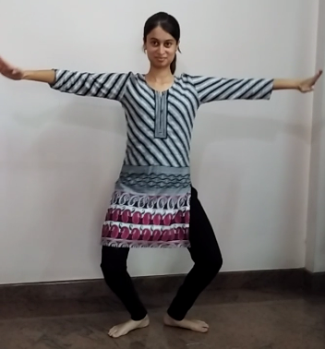
Joints Detected
Face
Neck
Shoulders
Hips
Knees

Slide 16
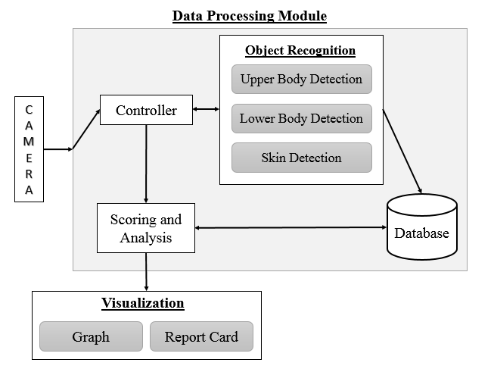
Architecture of the Tool

Slide 17
Haar Training
Type of Machine Learning Algorithm used to detect features and objects.
This cascade classifier has two stages:
Training
Detection

Slide 18
Training our Haar Classifier
955+ positive images
1500+ negative images
Use the OpenCV utility to create samples and train the classifier.
The length, width, number of positive images, number of negative images, number of stages , and type of training have to be specified.
The final output is an XML file which can then be used for object detection.

Slide 19
Upper Body Detection
Face contour detected first
Center of the smallest contour marked as the joint considered for the face
4% of the face length is added below the face to mark the neck joint
Face Contour lies within the Upper Body Contour
Shoulder joints are marked on the base of the Upper Body Contour at a distance of one fifth of the width

Slide 20
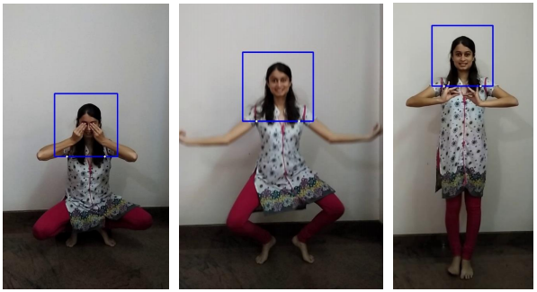
Upper Body Detection for the Standing and Sitting Postures

Slide 21
Lower Body Detection
Smallest contour detected within the bottom half of the image marked as the Lower Body Contour
Hip joints marked on the top line of the contour detected at the distance of one third from the edges
Knee joints marked on the halfway line of the contour detected for the lower body
Knee joints marked based on the Y coordinate of face joint
Y < 35% – Standing Dancer - Knees marked at one third the width from the sides
Y > 35% and Y < 65% - Aramandi pose - Knees marked at one fifth of the width from the sides
Y > 65%, the dancer is assumed to be sitting and the knees are marked on the sides of the contour detected.

Slide 22
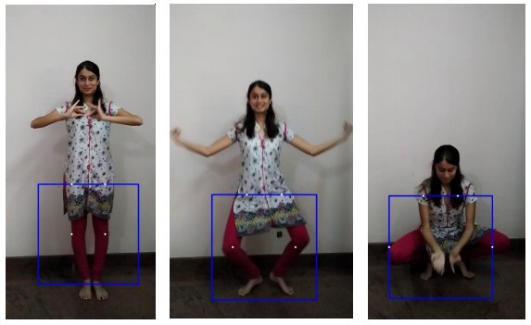
Lower Body Detection for the Standing and Sitting Postures

Slide 23
Skin Detection
Hand postures are determined using the skin detection mechanism.
A simple RGB combination is used to do the task.
The postures are broadly divided into 5 categories.
In case any of the joints or postures are not detected for a frame, the values are picked up from the previous frame.

Slide 24
Calculating Joint Velocity
Each frame is represented as a list of 16 elements.
x and y coordinate of 8 joints
The position of the 8 joints in one frame are compared to that in the next frame.
This value is used to calculate the velocity of the 8 joints.
The above process is followed for professional and amateur dancer.
Based on the accuracy detected, grades are allotted.

Slide 25
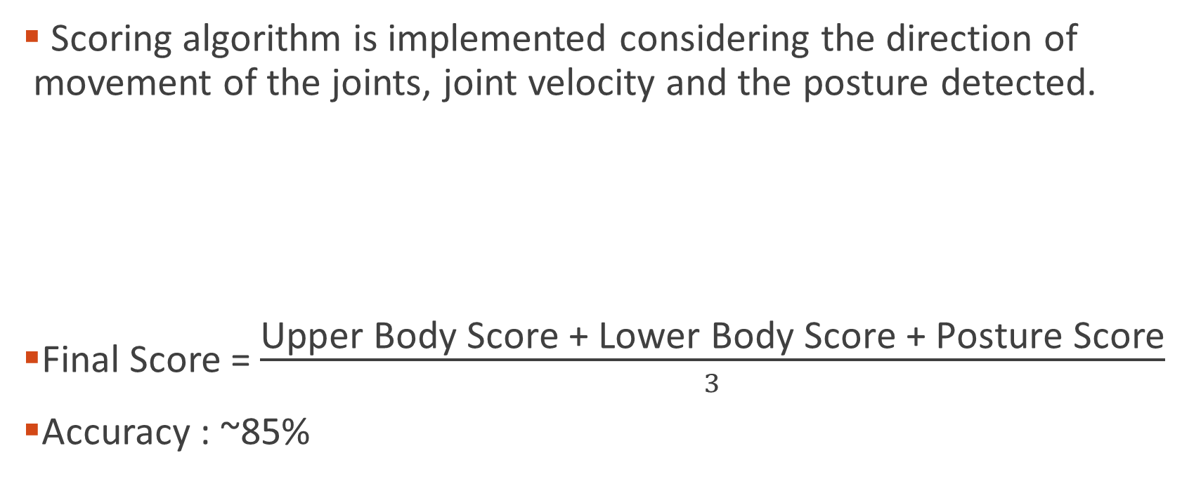
Scoring Algorithm
Scoring algorithm is implemented considering the direction of movement of the joints, joint velocity and the posture detected.
Final Score = $\frac{\text{Upper} \text{Body} \text{Score}\text{ + }\text{Lower} \text{Body} \text{Score}\text{ + }\text{Posture} \text{Score}}{3}$
Accuracy : ~85%
Inaccuracy | Score assigned
0 - 10% | 10
11 - 15% | 5
16 -20% | 3
> 20% | 0

Slide 26
Visualization
The average scores of the upper body joints, lower body joints and the postures are displayed in the final report.
Graph displayed at the end of the analysis
Shows the scores allotted for each frame
Helps the user compare their performance with that of the choreographer by comparing the corresponding frames of the user and the choreographer
A report card is provided along with a graph and a list of suggestions for improvement.

Slide 27
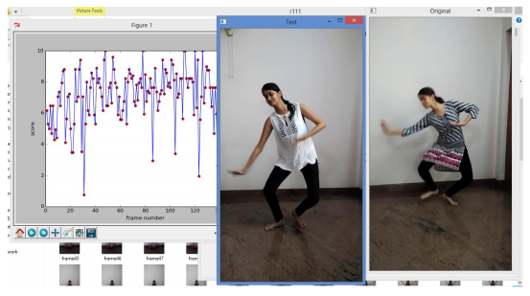
Comparing the student’s frame with the corresponding frame of the choreographer

Slide 28
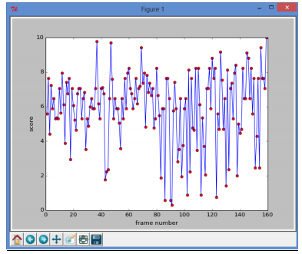
Graph plotted with the score for every frame

Slide 29
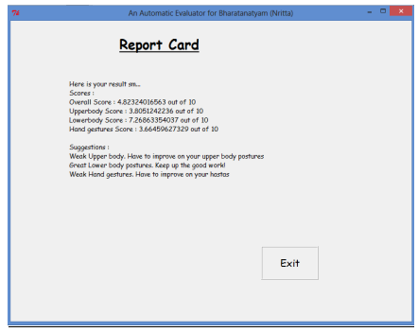
Report Card printed at the end of the Analysis

Slide 30
Thank You!

